Slide 1
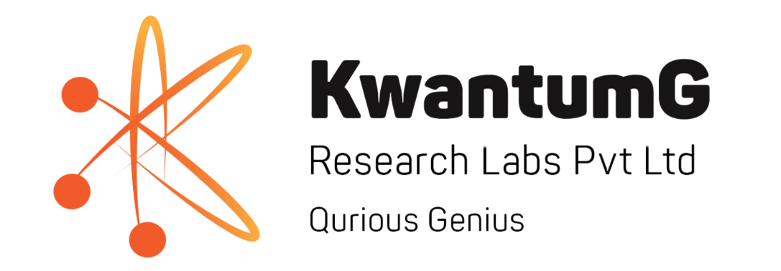
SDLC
11-Mar-2025
Karthiganesh Durai
Founder & CEO, KwantumG Research Labs Pvt Ltd, Bengaluru
Co-Founder, Quantum Computing India, Bengaluru
Professor of Practice, NMIT, Bengaluru
TJohn, Bengaluru
DevOps Workshop
1/1, 11-Mar-2025

Slide 2
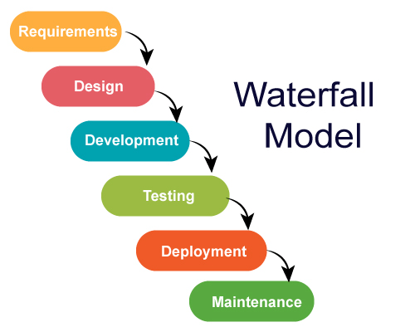
Waterfall
PROs
Clear Structure & Simplicity
Well-Documented Process
Suitable for Small or Well-Defined Projects
Efficient for Projects with Strict Regulations
Easy Testing and Verification
CONs
Rigid & Inflexible to Changes
Late Testing & High Cost of Errors
Not Suitable for Complex or Evolving Projects
Slow Feedback & Risk of Misalignment
Higher Risk in Long-Term Projects
No Overlapping Phases
https://medium.com/@chathmini96/waterfall-vs-agile-methodology-28001a9ca487
TJohn, Bengaluru
DevOps Workshop
1/1, 11-Mar-2025

Slide 3
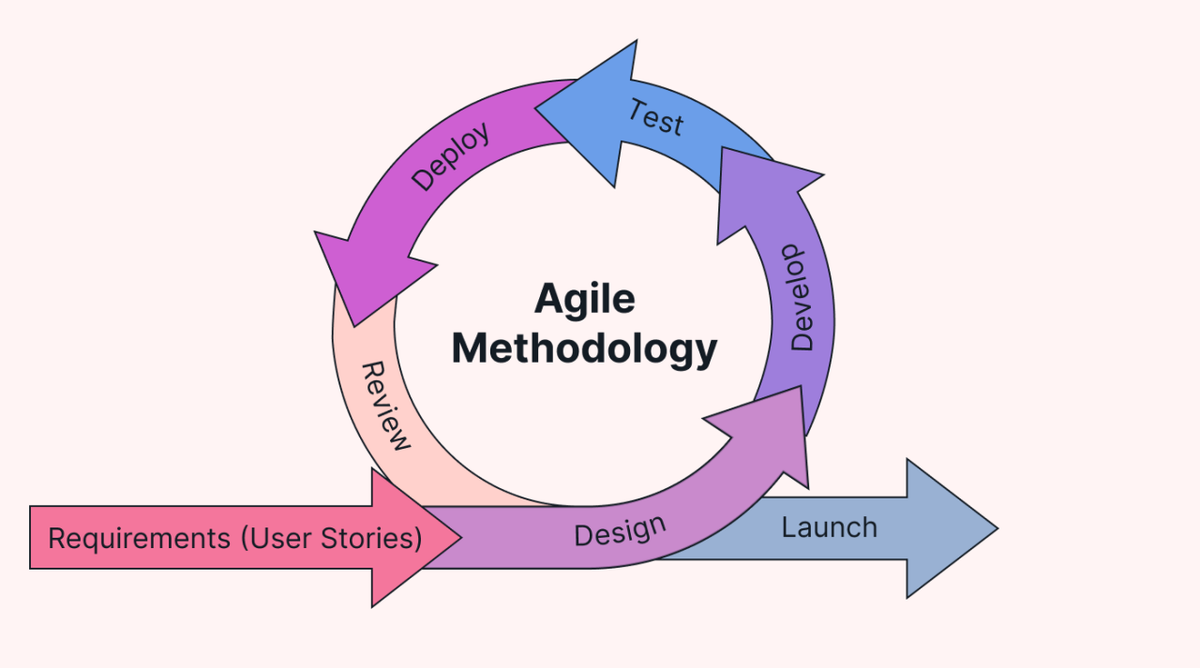
Agile
PROs
Faster Delivery & Time-to-Market
Flexibility & Adaptability
Better Customer Collaboration
Improved Product Quality
Increased Team Engagement
CONs
Less Predictability
Requires High Customer Involvement
Scope Creep
Difficult for Large-Scale Projects
High Dependence on Skilled Teams
Integration Challenges with External Teams
https://www.linkedin.com/pulse/agile-methodologies-navigating-change-software-development-ejie-eukdf/
TJohn, Bengaluru
DevOps Workshop
1/1, 11-Mar-2025

Slide 4
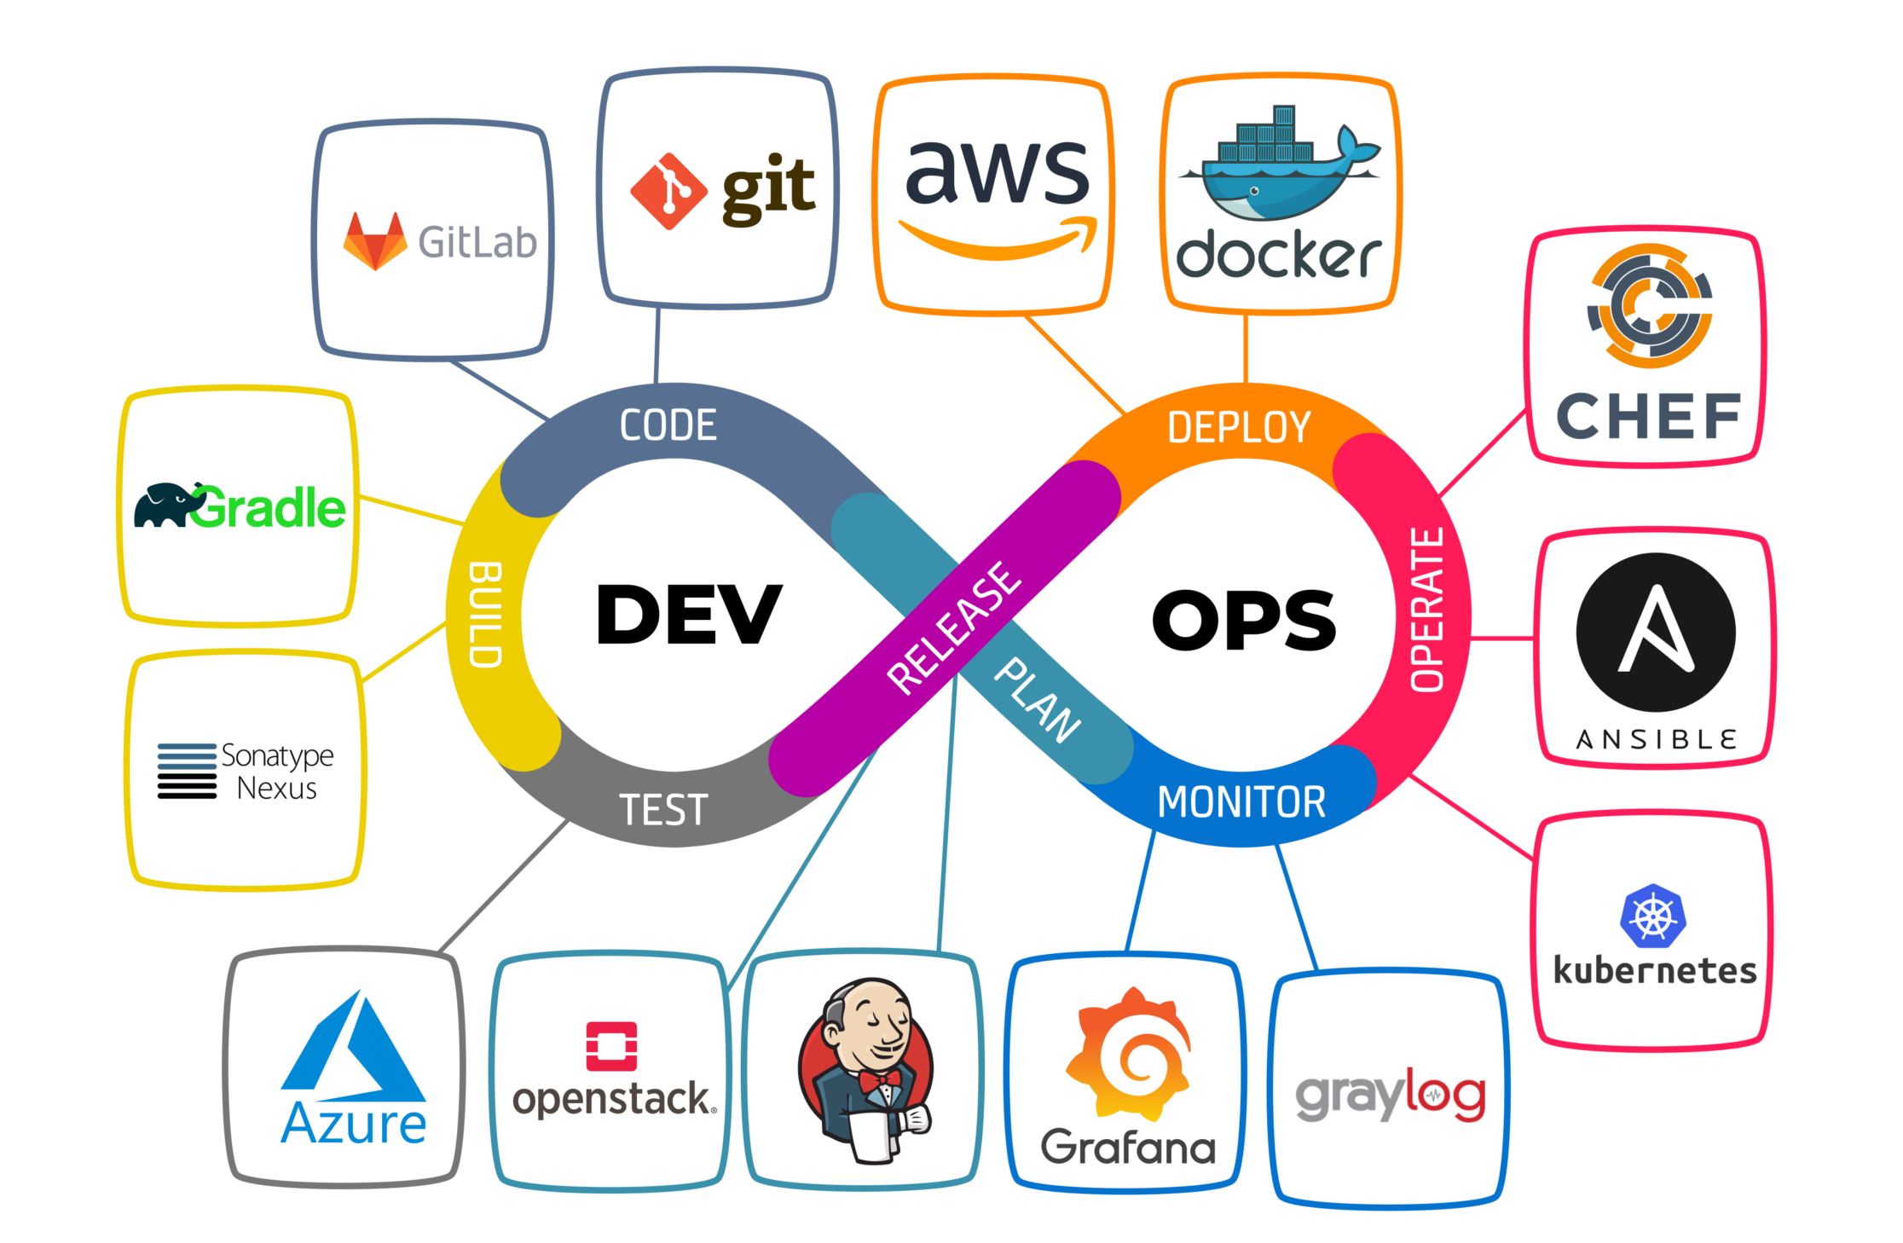
DevOps
PROs
Faster Software Delivery
Improved Collaboration
Higher Deployment Frequency
Enhanced Reliability and Stability
Cost Efficiency
CONs
Complexity in Implementation
High Initial Investment
Resistance to Change
Over-Reliance on Automation
Not Suitable for Every Organization
https://www.linkedin.com/pulse/agile-methodologies-navigating-change-software-development-ejie-eukdf/
TJohn, Bengaluru
DevOps Workshop
1/1, 11-Mar-2025

